Slide 1
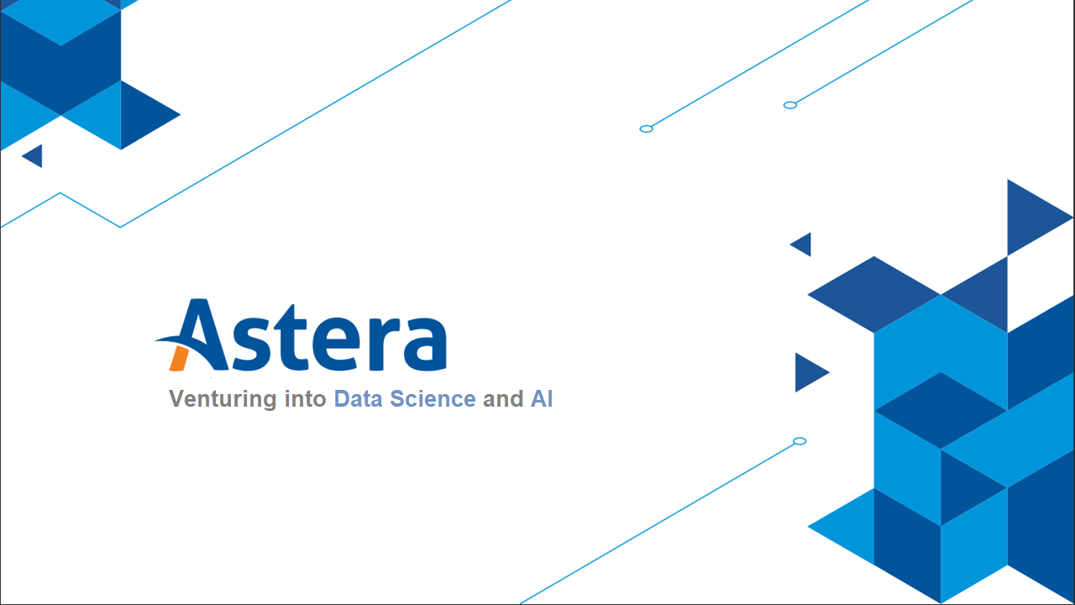

Slide 2

Topics
Diagnostics Modeling vs Predictive Modeling

Slide 3
Diagnostic Modeling vs Predictive Modeling
There are two main reasons to build models
Inference
Prediction

Slide 4
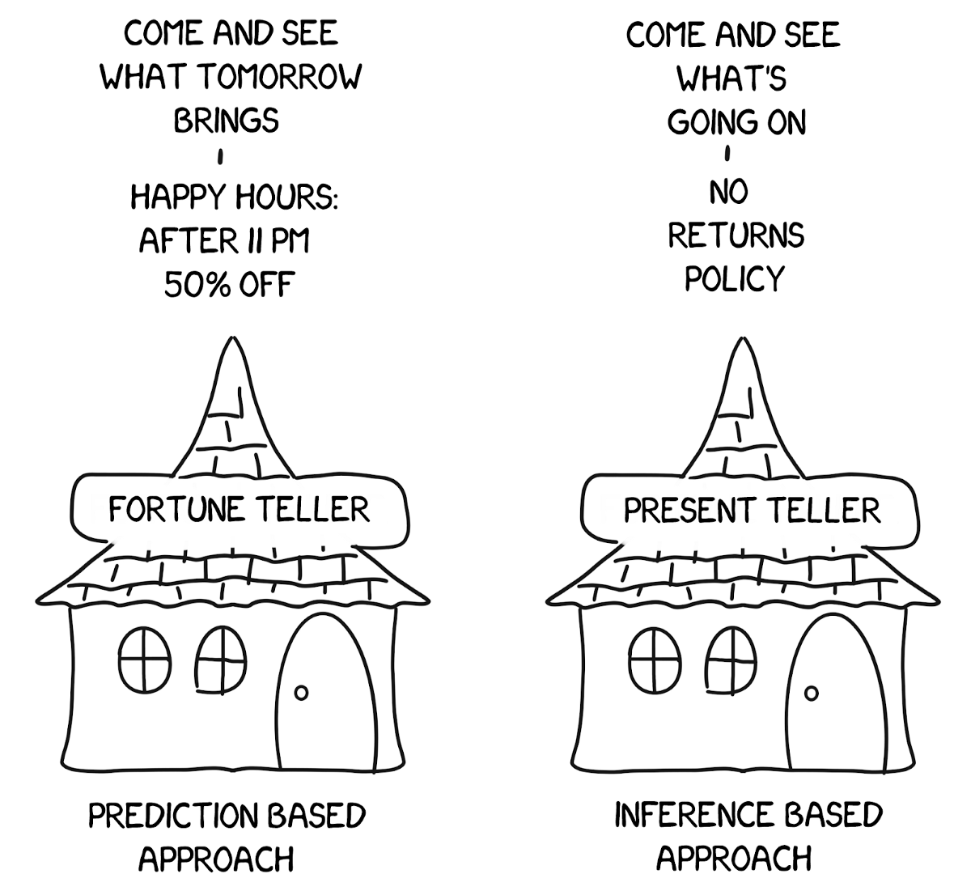
Diagnostic Modeling vs Predictive Modeling

Slide 5

Predictive Modeling: Predictions
In many situations, a set of inputs X (Independent Variables) is readily available, but the output Y (Dependent Variable) cannot be easily obtained.
In this setting, the model can be often treated as a black box, in the sense that one is not typically concerned with the exact working of the model if it yields accurate predictions for Y.

Slide 6
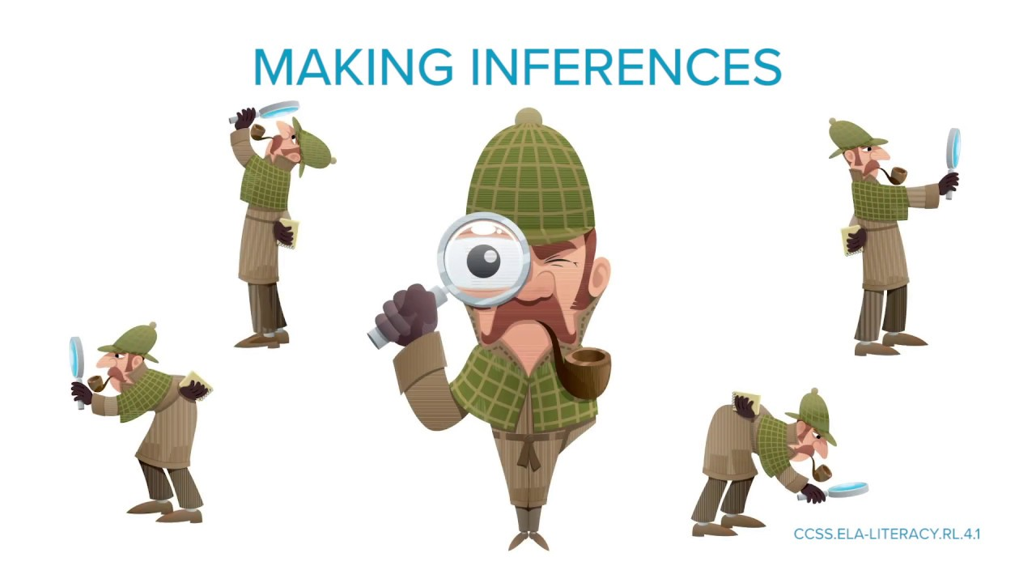
Diagnostic Modeling: Inferences
We are often interested in understanding the association between Y (Dependent Variable) and X (Independent Variables).
In this situation, we wish to build the model, but our goal is not necessarily to make predictions. Now the model cannot be treated as a black box, because we need to know its exact form in order to understand the association between the variables.

Slide 7
Diagnostic Modeling: Inferences
In this setting, one may be interested in answering the following questions:
Which predictors are associated with the response?
What is the relationship between the response and each predictor?
Can the relationship between Y and each predictor be adequately summarized using a linear equation, or is the relationship more complicated?

Slide 8
Diagnostic Modeling Process
Problem Formulation: Define the research question or the problem that needs to be investigated.
2. Data Collection: Collect data on the relevant variables and the outcome of interest.
3. Data Preparation: Clean and preprocess the data, handle missing values, and transform the data as needed.
4. Model Specification: Select the appropriate statistical model that can explain the relationship between the variables.
5. Model Estimation: Estimate the parameters of the model using the data.
6. Model Evaluation: Evaluate the goodness of fit of the model, test the significance of the parameters, and assess the assumptions of the model.
7. Results Interpretation: Interpret the model results and draw conclusions about the relationships between the variables.

Slide 9
Predictive Modeling Process
Problem Formulation: Define the prediction task and the outcome variable that needs to be predicted.
2. Data Collection: Collect data on the relevant predictors and the outcome variable.
3. Data Preparation: Clean and preprocess the data, handle missing values, and transform the data as needed.
4. Model Selection: Select an appropriate algorithm that can learn from the data and make accurate predictions.
5. Model Training: Use the data to train the model and estimate its parameters.
6. Model Evaluation: Evaluate the performance of the model using a test set or cross-validation.
7. Results Interpretation: Interpret the model results and use them to make predictions about new data.

Slide 10

THANK YOU
Training and Certification

